Slide 1
Introduction to Statistical Methods (ISM)
ISM Team

Slide 2
Course No: AIML ZC418 , Lecture No. 1
Overview of the course & Basic of Statistics

Slide 3

Overview of the course
Module 1 : Basic Probability & Statistics
Module 2 : Conditional Probability & Bayes’ theorem
Module 3 : Probability Distributions
Module 4 : Hypothesis Testing
Module 5 : Prediction & Forecasting
Module 6 : Prediction & Forecasting; Gaussian Mixture model &Expectation Maximization

Slide 4
TEXT BOOKS
T1 : Statistics for Data Scientists, An introduction to Probability, Statistics and Data Analysis, Maurits Kaptein et al, Springer 2022
T2 : Probability and Statistics for Engineering and Sciences,8th Edition, Jay L Devore, Cengage Learning
T3 : Introduction to Time Series and Forecasting, Second Edition , Peter J Brockwell, Richard A Davis, Springer.

Slide 5
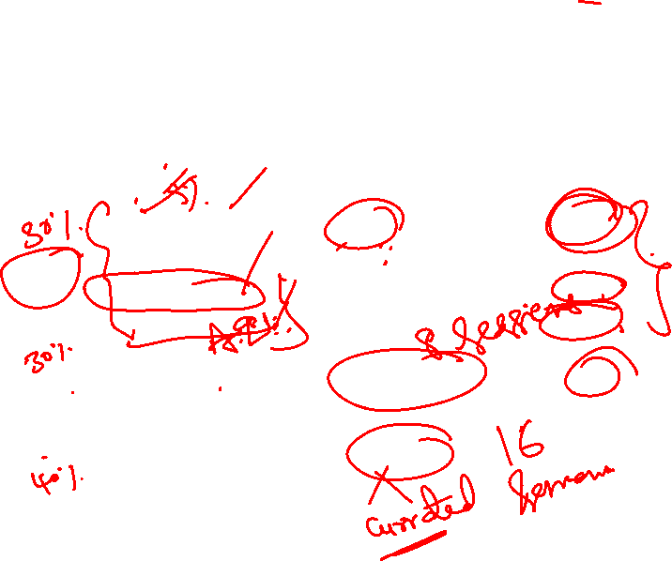

TEXT BOOKS
Evaluation Components
 | Name | Type | Weightage
EC 1 | Quiz 1 & Quiz 2 | Online | 10%
 | Assignment 1 Situated Learning | Online Online | 10% 10%
EC 2 | Mid semester Exam | Closed Book | 30%
EC 3 | Comprehensive Exam | Open Book | 40%

Slide 6
Module 1: (Basic Probability & Statistics)
Contact Session | List of Topic Title | Reference
CS - 1 | Measures of Central Tendency & Measures of Variability, Data – Symmetric & Asymmetric, outlier detection, 5 point summary | T1 & T2

Slide 7
Statistics
Statistics is a branch of Applied Mathematics
Statistics is the back-bone of Data Science, AI & ML and all Information Technologies

Slide 8
Statistics
Statistics may be defined as science that is employed to
Collect the data
Present and organize the data in a systematic manner
Analyse the data
Infer about the data
Take decision from the data.
Statistics is a Data(Information) driven decision making Science.

Slide 9
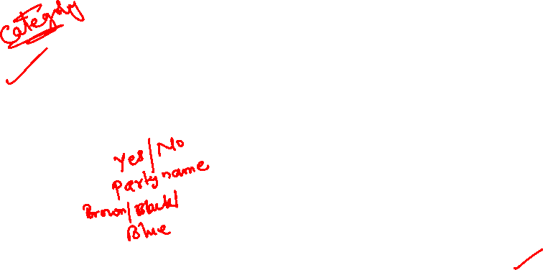
Data - Types
Data
Categorical(Qualitative)
Numerical(Quantitative)
Examples:
  Marital Status
  Political Party
  Eye Color
(Defined categories)
Discrete
Continuous
Examples:
Number of Children
Defects per hour
(Counted items)
Examples:
Weight
Voltage
(Measured characteristics)

Slide 10
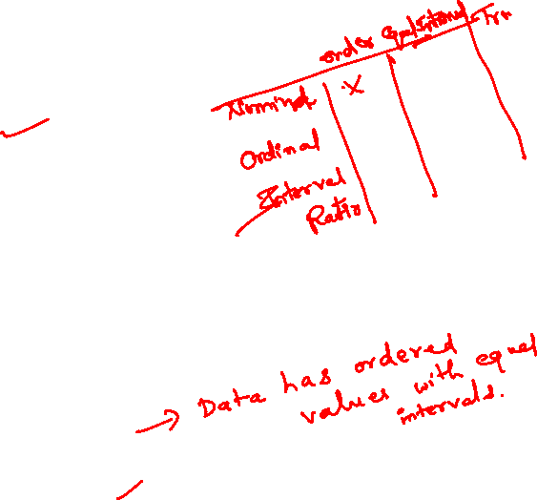
Levels of Data Measurement
Nominal — Lowest level of measurement
Ordinal
Interval
Ratio — Highest level of measurement
Nominal
A nominal scale classifies data into distinct categories in which no ranking is implied
Example : Gender, Marital Status, voting to different party
Ordinal scale
An ordinal scale classifies data into distinct categories in which ranking is implied
Example:
Product satisfaction: Satisfied, Neutral, Unsatisfied
Faculty rank: Professor, Associate Professor, Assistant Professor
Student Grades: A, B, C, D, F
Medals won: Gold, Silver, Bronze
Interval scale
An interval scale is an ordered scale in which the difference between measurements is a meaningful quantity but the measurements do not have a true zero point.
Example
Temperature in Fahrenheit and Celsius
Months of the Year: there’s no month called zero and we can’t say January is twice as much as June.
Ratio Scale
A ratio scale is an ordered scale in which the difference between the measurements is a meaningful quantity and the measurements have a true zero point.
Examples
Weight , Age , Salary

Slide 11
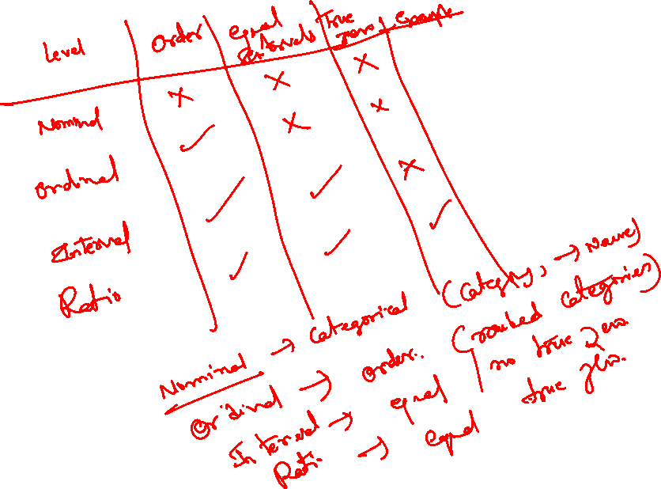

Slide 12

Variables
Types of Variable
Qualitative (Categorical): express a qualitative attribute such as hair color, eye color, religion.
Quantitative(Numerical): measured in terms of numbers such as height, weight, number of people.
Nominal:
No ordering is possible such as hair color, eye color, religion.
Ordinal:
Ordering is possible such as health, which can take values such as poor, reasonable, good, or excellent.
Discrete: countable and have a finite number of possibilities such as number of people
Continuous:not countable and have an infinite number of possibilities such as height
INTERVAL: ratio of values of variable do not have any meaning and it does not have an inherently defined zero value such as temperature
RATIO: ratio of values of variable have meaning and it have an inherently defined zero value such as length

Slide 13
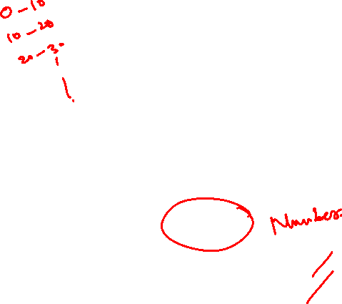
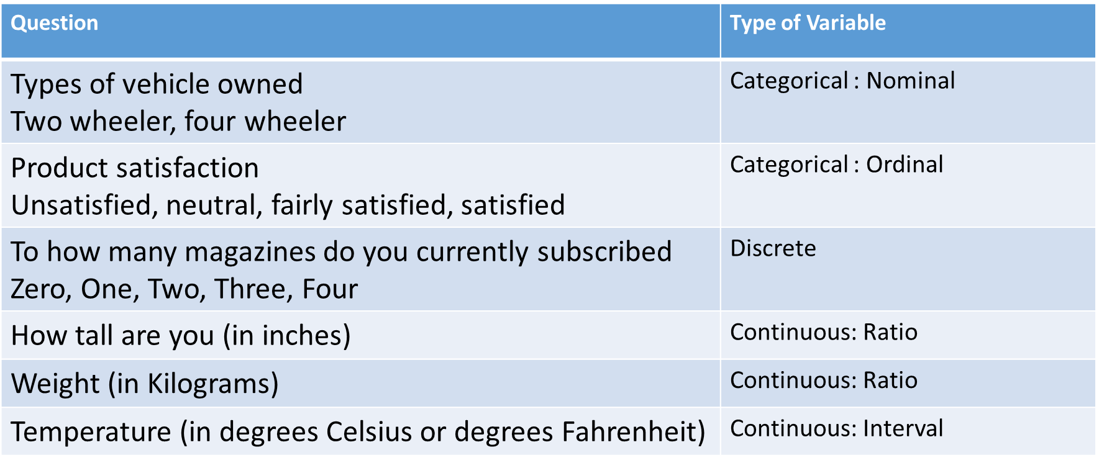
Example

Slide 14
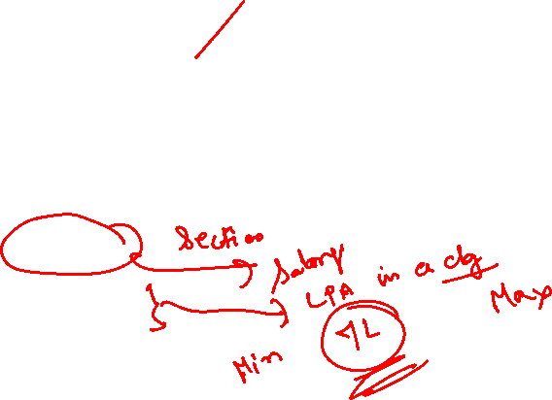
Measures of Central Tendency
Measure of central tendency provides a very convenient way of representing (reducing/summarizing) a data set with a single number that describes the significance of the whole data set.
  Also defined as a single value that is used to describe the “center” of the data.
  Three commonly used measures of central tendency:
    Mean
    Median
    Mode

Slide 15
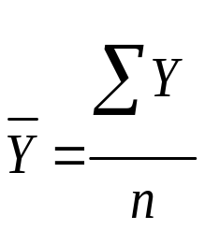
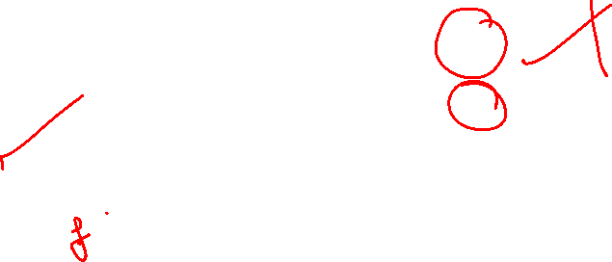
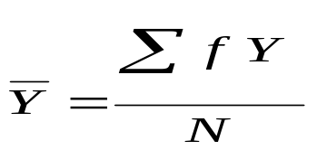
Mean
Also referred as the “arithmetic average”
The most commonly used measure of the center of data
Numbers that describe what is average or typical of the distribution
Computation of Sample Mean:
Computation of the Mean for grouped Data
where f Y = a score multiplied by its frequency

Slide 16
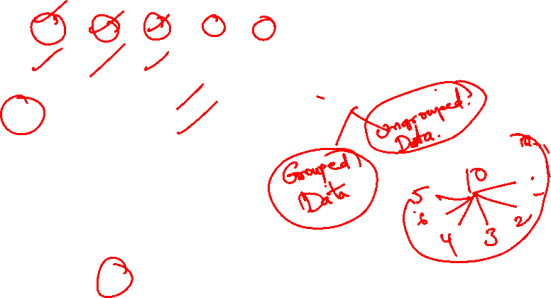
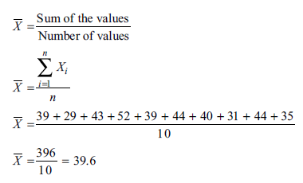
Mean: Ungrouped Data
Suppose you define the time to get ready as the time (rounded to the nearest minute) from when you get out of bed to when you leave your home. You collect the times shown below for 10 consecutive work days:
Day | 1 | 2 | 3 | 4 | 5 | 6 | 7 | 8 | 9 | 10
Time (min) | 39 | 29 | 43 | 52 | 39 | 44 | 40 | 31 | 44 | 35

Slide 17
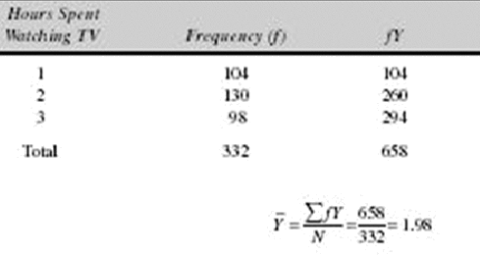
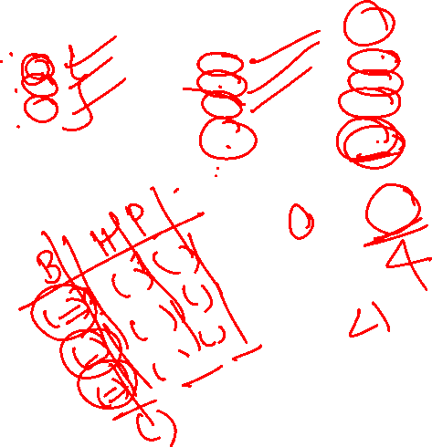
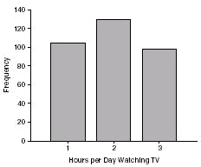
Mean: Frequency Distribution distribution
Data of Children watching TV in Bengaluru

Slide 18
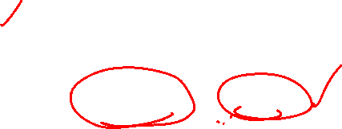
Mean
PROPERTIES
Mean is the most stable among other measures of central tendency because every score contributes to the value of the mean.
It may easily be affected by the extreme scores.
The sum of each score’s distance from the mean is zero.
It may not be an actual score in the distribution
It is very easy to compute.
When to Use the Mean
Data is quantitative in nature without extreme/outlier observations.
It can be applied to interval and ratio levels of measurements
Sampling stability is desired.
Other measures are to be computed such as standard deviation, coefficient of variation and skewness

Slide 19
The Mode
The category or score with the largest frequency (or percentage) in the distribution.
The mode can be calculated for variables with levels of measurement that are: nominal, ordinal, or interval-ratio.
Example:
A systems manager in charge of a company s network keeps track of the number of server failures that occur in a day. Compute the mode for the following data, which represents the number of server failures in a day for the past two weeks:.
1 3 0 3 26 2 7 4 2 3 3 6 3
Because 3 appears five times, more times than any other value, the mode is 3. Thus, the systems manager can say that the most common occurrence is having three server failures in a day.

Slide 20
Mode
Properties
It can be used when the data are qualitative as well as quantitative.
It may not be unique.
It is not affected by extreme values.
When to Use the Mode
    When the data set is measured on a nominal scale
    A decision is desirably taken on the basis maximum frequent occurrences.

Slide 21
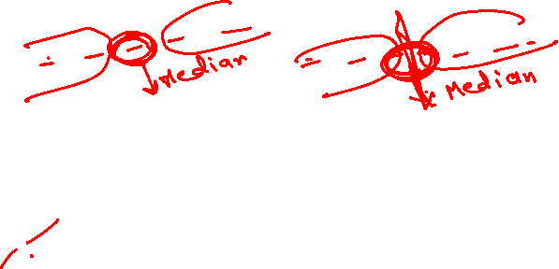
The Median
The score that divides the distribution into two equal parts, so that half the cases are above it and half below it.
You compute the median value by following one of two rules:
Rule 1 If there are an odd number of values in the data set, the median is the middle-ranked value.
Rule 2 If there are an even number of values in the data set, then the median is the average of the two middle ranked values.

Slide 22
Median
Properties
The median is the middle positional score, or average of middle scores in a distribution.
    Fifty percent (50%) lies below the median value and 50% lies above the median value.
    It is also known as the middle score or the 50th percentile/middle quartile.
    Median is never affected by extreme observations/Outliers
    Uses
    Even though it is applicable for all types of measurement scales, it is more useful for ordinal measurement scales.
    It is a best measure where the influences of extreme observations/Outliers are not required.

Slide 23
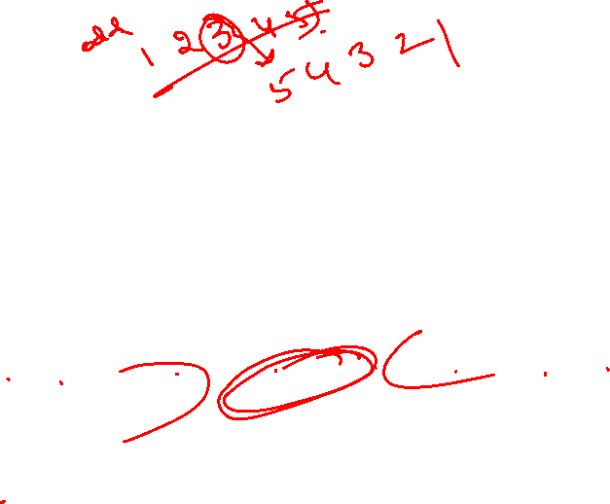
The Median
Example-1: The three-year annualized returns for the seven small-cap growth funds with low risk are ranked from the smallest to the largest:
The Median is the 4th position value i.e. 22.4.
Example-2: Consider the time taken for reaching office from home in minutes arranged from lowest to highest
29 31 35 39 39 40 43 44 44 52
The number of observations are 10. Hence the median is the average of values at the 5th and 6th Position, i.e. average of 39 and 40 = 39.5

Slide 24
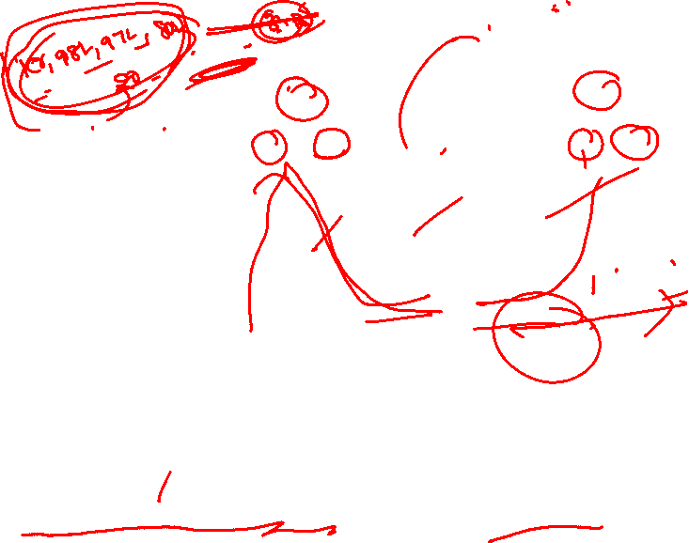
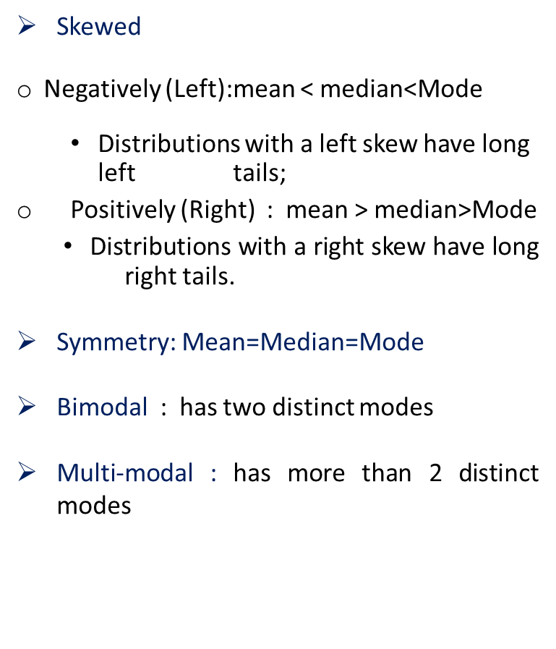
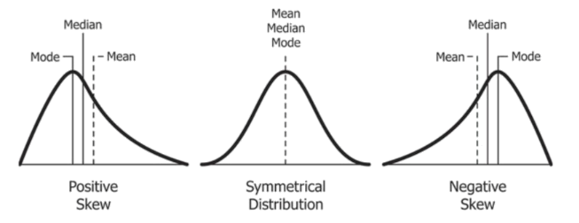
Data distribution-Skew (Asymmetry) & Symmetry
Note: In science, an empirical relationship is a relationship that is supported by experiment and observation but not necessarily supported by theory. For moderately skewed/unskew data, an empirical relationship is observed as Mode = 3Median-2Mean. Further Mean is applied for unskew/moderately skewed data whereas median is a preferred measure for heavily skewed data.

Slide 25
Why mean(measure of central tendency) is not enough?
Sl. No. | X₁
1 | 2
2 | 8
3 | 5
4 | 3
5 | 7
6 | 8
7 | 5
8 | 2
9 | 5
Total | 45
Statistical measures | Group 1
Mean | 5
Median | 5
Mode | 5

Slide 26
Why mean(measure of central tendency) is not enough?
Sl. No. | X₁
1 | 2
2 | 8
3 | 5
4 | 3
5 | 7
6 | 8
7 | 5
8 | 2
9 | 5
Total | 45
Statistical measures | Group 1
Mean | 5
Median | 5
Mode | 5

Slide 27

Sl. No. | X₁
1 | 2
2 | 8
3 | 5
4 | 3
5 | 7
6 | 8
7 | 5
8 | 2
9 | 5
Total | 45
Statistical measures | Group 1 & 2
Mean | 5
Median | 5
Mode | 5

Slide 28

Do we need any other measure?
Answer: Yes
Measures of variability/dispersion/spread
Measures of Variability:
The Range
The Variance
The Standard Deviations
Quartile deviation

Slide 29

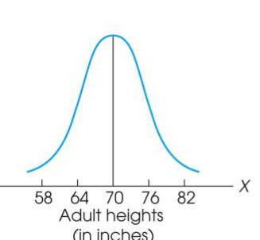
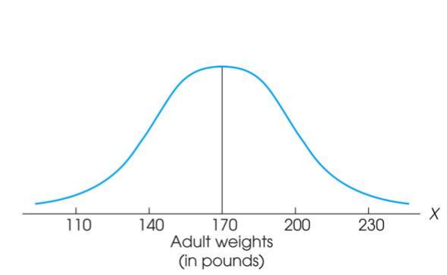
Measure of Variability
Variability can be defined several ways:
A quantitative distance measure based on the differences between scores
Describes distance of the spread of scores or distance of a score from the mean
Purposes of Measure of Variability:
Describe the distribution
Measure how well a measure of central tendency represents the distribution

Slide 30
The Ranges
The distance covered by the scores in a distribution – From smallest value to highest value
For continuous data, real limits are used
Based on two scores, not all the data – An imprecise, unreliable measure of variability
Range = URL for X_{max} - LRL for X_{min}
Example: For a set of scores: 7, 2, 7, 6, 5, 6, 2
Range = Highest Score minus Lowest score = 7 - 2 = 5

Slide 31
The Standard Deviation
Most common and most important measure of variability is the standard deviation
  A measure of the standard, or average, distance from the mean
  Describes whether the scores are clustered closely around the mean or are widely scattered
Calculation differs for population and samples
Variance is a necessary companion concept to standard deviation but not the same concept

Slide 32
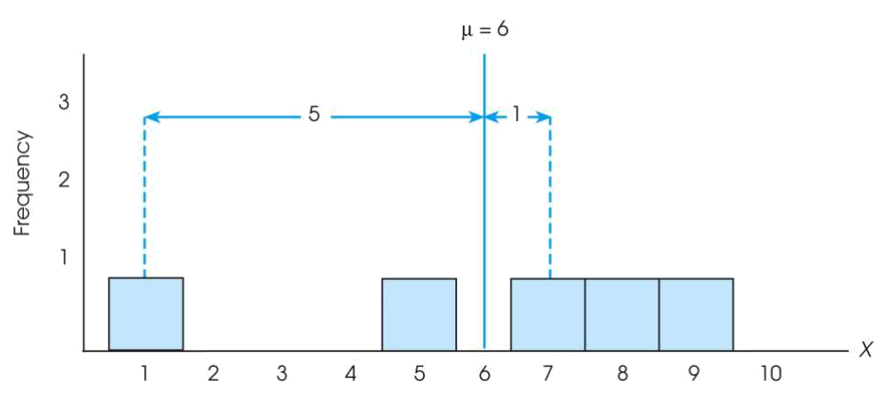
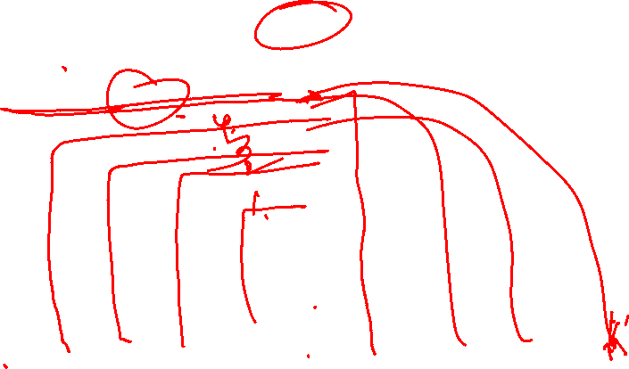
The Standard Deviation
Exercise : Find out the deviations of all the data points with the mean….and then find the ‘mean deviation’.

Slide 33

The Standard Deviation
Sum of mean deviations is always ‘zero’ !
(because Mean is a balance point)
Then, how do you find ‘Standard Deviation’ ?
Need a new strategy

Slide 34


The Standard Deviation
New Strategy :
  First square each deviation score
  Then sum the Squared Deviations (SS)
  Average the squared deviations
  Mean Squared Deviation is known as “Variance”
  Variability is now measured in squared units

Slide 35

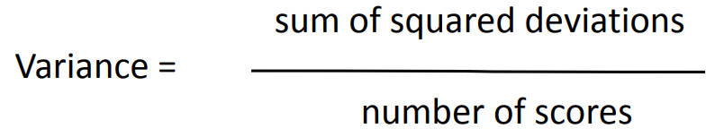
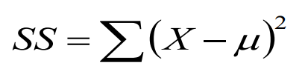

Variance equals mean (average) squared deviation (distance) of the scores from the mean
Where,

Slide 36
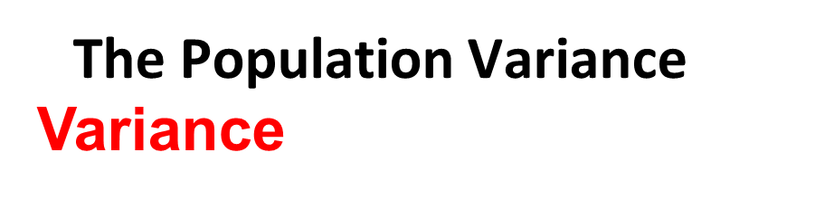
Population variance equals mean (average) squared deviation (distance) of the scores from the population mean
Variance is the average of squared deviations, so we identify population variance with a lowercase Greek letter sigma squared: σ²
Standard deviation is the square root of the variance, so we identify it with a lowercase Greek letter sigma: σ

Slide 37
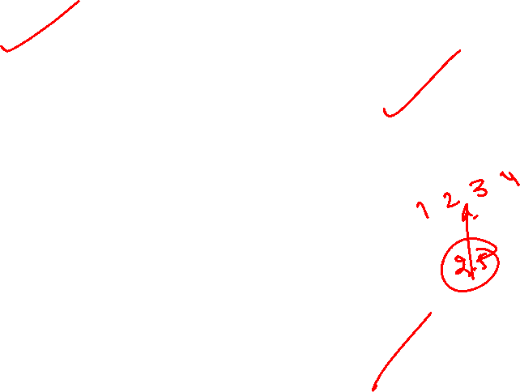
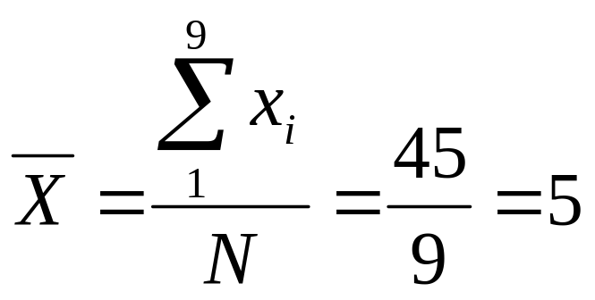
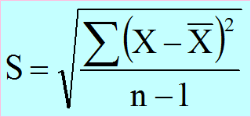
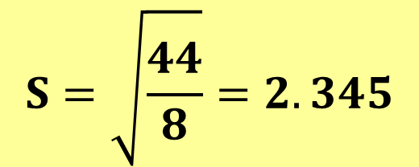
Sl. No. | X₁
1 | 2
2 | 8
3 | 5
4 | 3
5 | 7
6 | 8
7 | 5
8 | 2
9 | 5
Total | 45

Slide 38

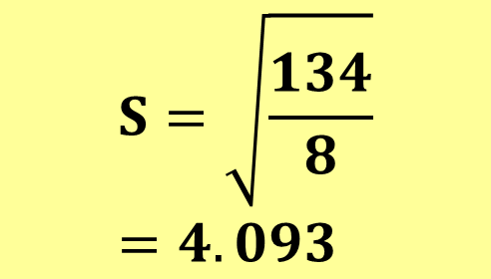
Sl. No. | X₂
1 | 1
2 | 15
3 | 5
4 | 5
5 | 6
6 | 3
7 | 5
8 | 2
9 | 3
Total | 45

Slide 39
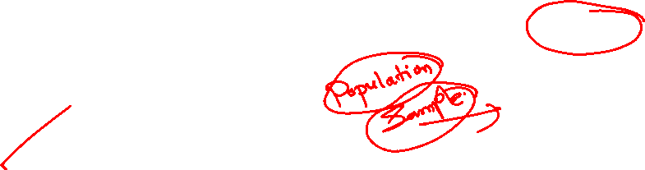
Goal of inferential statistics:
  Draw general conclusions about population based on limited information from a sample
Samples differ from the population
  Samples have less variability
  Computing the Variance and Standard Deviation in the same way as for a population would give a biased estimate of the population values

Slide 40
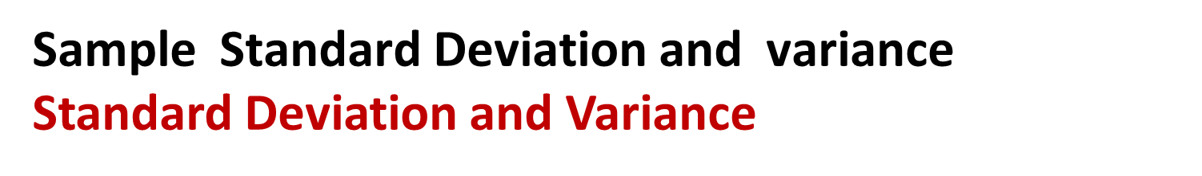
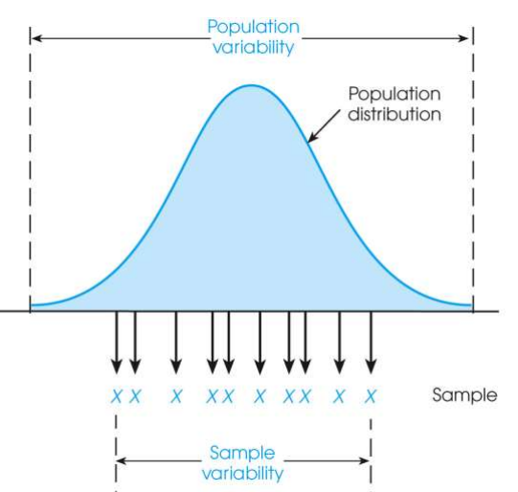
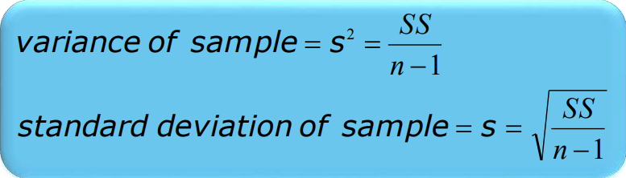
Sum of Squares (SS) is computed as before
Formula for Variance has n-1 rather than N in the denominator
Notation uses s instead of σ

Slide 41
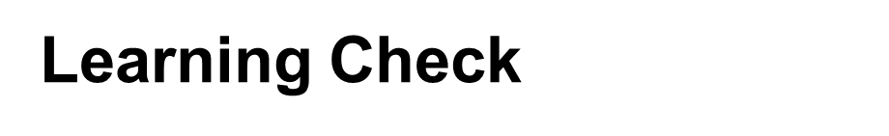
Select the correct option
A sample of four scores has SS = 24. What is the variance?
The variance is 6
The variance is 7
The variance is 8
The variance is 12
A sample systematically has less variability than a population
The standard deviation is the distance from the Mean to the farthest point on the distribution curve
True / False ?
True / False ?

Slide 42
Learning check
Select the correct option
A sample of four scores has SS = 24. What is the variance?
The variance is 6
The variance is 7
The variance is 8
The variance is 12
True
A sample systematically has less variability than a population
The standard deviation is the distance from the Mean to the farthest point on the distribution curve
False

Slide 43

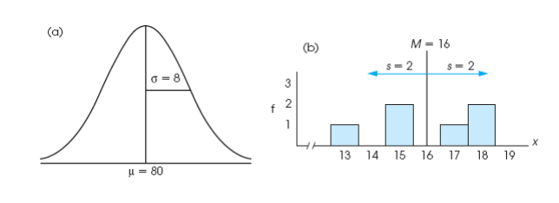
A standard deviation describes scores in terms of distance from the mean
Describe an entire distribution with just two numbers (M and s)
Reference to both allows reconstruction of the measurement scale from just these two numbers
Means and standard deviations together provide extremely useful descriptive statistics for characterizing distributions

Slide 44

The five number summary of data includes 5 items:
Minimum.
Q1 (the first quartile, or the 25% mark).
Median.
Q3 (the third quartile, or the 75% mark).
Maximum.

Slide 45
It is measure of Variation
Also Known as Mid-spread : Spread in the Middle 50%
Difference Between Third & First Quartiles:
Not Affected by Extreme Values
Interquartile Range = IQR = Q₃ – Q₁
Data in Ordered Array: 11 12 13 16 16 17 17 18 21
1•(9 + 1)
Q₁
=12.5
Position of Q₁
= 2.50,
4
Q₃
=17.5
3•(9 + 1)
= 7.50,
Position of Q₃
4
Interquartile Range = IQR= Q₃ – Q₁ = 17.5 - 12.5 = 5
QD = IQR/2 = 5/2 = 2.5 (variation among the data in the central 50% of a data set)

Slide 46

IQR = Q₃ – Q₁
Q₁-1.5 IQR
Q₃+1.5 IQR
Min
Max
Q₁
Q₂
Q₃
Outlier
Outlier

Slide 47

IQR = Q₃ – Q₁
Min
Q₁-1.5 IQR
Q₃+1.5 IQR
Max
Q₁
Q₂
Q₃
Q₃+3 IQR
Q₁-3 IQR
Major Outlier
Major Outlier

Slide 48
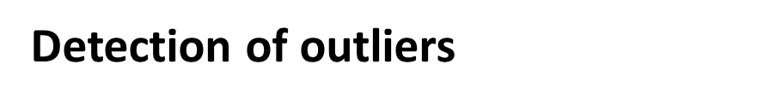
Data in Ordered Array of the previous data: 11 12 13 16 16 17 17 18
Q₁-1.5 IQR =5, 11 12 13 16 16 17 17 18, Q₃+1.5 IQR = 25
As all the above data points lie in between Q₁-1.5 IQR and Q₃+1.5 IQR , the above data is free from Outliers/Extreme Values

Slide 49

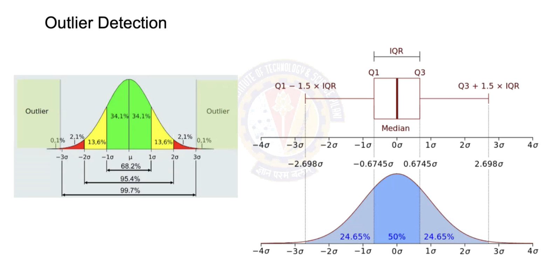
The lower limit and upper limit of a data set are given by:
Lower limit = Q₁ - 1.5 x IQR
Upper limit = Q₃ + 1.5 x IQR
Data points that lie below the lower limit or above the upper limit are potential outliers.

Slide 50

1.Measures of Central Tendency: Mean, Median, Mode
2. Measures of Variability: Range, Standard Deviation , Variance
3. Symmetric and Asymmetric distribution
4. Five - point summary
5. Outliers

Slide 51

Q.1 A sample of 77 individuals working at a particular office was selected and the noise level (dBA) experienced by everyone is the following data:
55.3, 55.3, 55.3, 55.9, 55.9, 55.9, 55.9, 56.1, 56.1, 56.1, 56.1, 56.1, 56.1, 56.8, 56.8, 57.0, 57.0, 57.0, 57.8, 57.8, 57.8, 57.9, 57.9, 57.9, 58.8, 58.8, 58.8, 59.8, 59.8, 59.8, 62.2, 62.2, 63.8, 63.8, 63.8, 63.9, 63.9, 63.9, 64.7, 64.7, 64.7, 65.1, 65.1, 65.1, 65.3, 65.3, 65.3, 65.3, 67.4, 67.4, 67.4, 67.4, 68.7, 68.7, 68.7, 68.7, 69.0, 70.4, 70.4, 71.2, 71.2, 71.2, 73.0, 73.0, 73.1, 73.1, 74.6, 74.6, 74.6, 74.6, 79.3, 79.3, 79.3, 79.3, 83.0, 83.0, 83.0.
Find a) Arithmetic Mean, SD, variance, and IQR
b) Draw box and whisker plot
c) Comment on the outliers, if any.

Slide 52

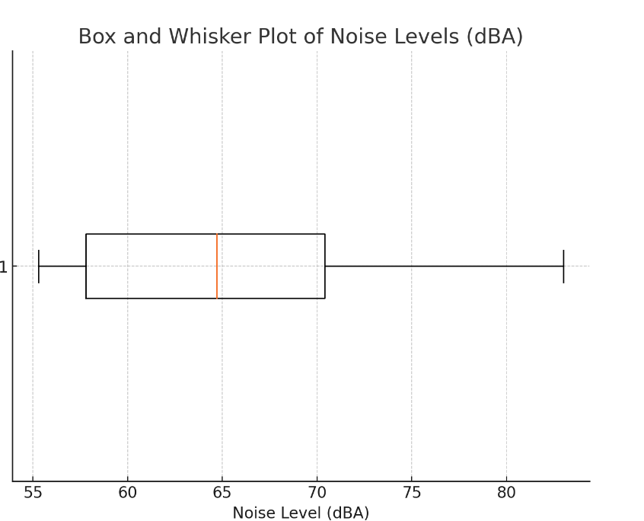
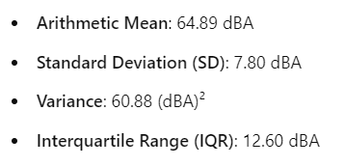
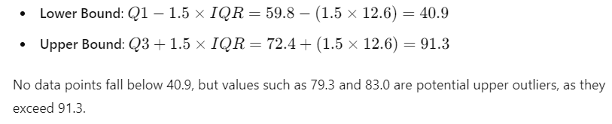

Slide 53

Q.2 The data given below is the total fat, in grams per serving, for a sample of 20 chicken sandwiches from fast-food chains.
7 8 4 5 16 20 20 24 19 30 23 30 25 19 29 29 30 30 40 56
a. Compute the mean, median, first quartile, and third quartile.
b. Compute the variance, standard deviation, range, interquartile range, Are there any outliers? Explain.
c. Are the data skewed? If so, how?
d. Based on the results of (a) through (c), what conclusions can you reach concerning the total fat of chicken sandwiches?

Slide 54

Q.3 The following data represent the battery life (in shots) for three pixel digital cameras:
300 180 85 170 380 460 260 35 380 120 110 240
List the Five-point summary.
Q.4 For the data set below:
a. Obtain and interpret the quartiles.
b. Determine and interpret the interquartile range.
c. Find and interpret the five-number(point) summary.
d. Identify potential outliers, if any.
e. Construct and interpret a boxplot.
82 | 45 | 64 | 80 | 82 | 74 | 79 | 80 | 80 | 78 | 80 | 80 | 48 | 73 | 80 | 79 | 81 | 70 | 78 | 73

Slide 55

Q.5 A bank branch located in a commercial place of a city has developed an improved process for serving customers during the noon-to-1:00 p.m. lunch period. The waiting time, in minutes (defined as the time the customer enters the line to when he or she reaches the teller window), of a sample of 15 customers during this hour is recorded over a period of one week. The results are: 4.21, 5.55, 3.02, 5.13, 4.77, 2.34, 3.54, 3.20, 4.50, 6.10, 0.38, 5.12, 6.46, 6.19, 3.79.
Another branch, located in a residential area, is also concerned with the noon-to-1 p.m. lunch hour. The waiting time, in of a sample of 15 customers during this hour is recorded over a period of one week. The results are listed below: 9.66, 5.90, 8.02, 5.79, 8.73, 3.82, 8.01, 8.35, 10.49, 6.68, 5.64, 4.08, 6.17, 9.91, 5.47.
a. List the five-number summaries of the waiting times at the two bank branches.
b. Construct box-and-whisker plots and describe the shape of the distribution of each for the two bank branches.
c. What similarities and differences are there in the distributions of the waiting time at the two bank branches?

Slide 56
Thank You!

